Slide 1
Binary Search Tree

Slide 2
Binary Search Tree (BST)
Binary trees have min 0 or 1 or 2 child
There is no systematic way to construct Binary trees
O(n) time is required to search an element
Binary Search tree have same properties
There is systematic way to add data in tree in order to provide ease

Slide 3
Left element should always be less than root element
Right element should be greater than root element

Slide 4
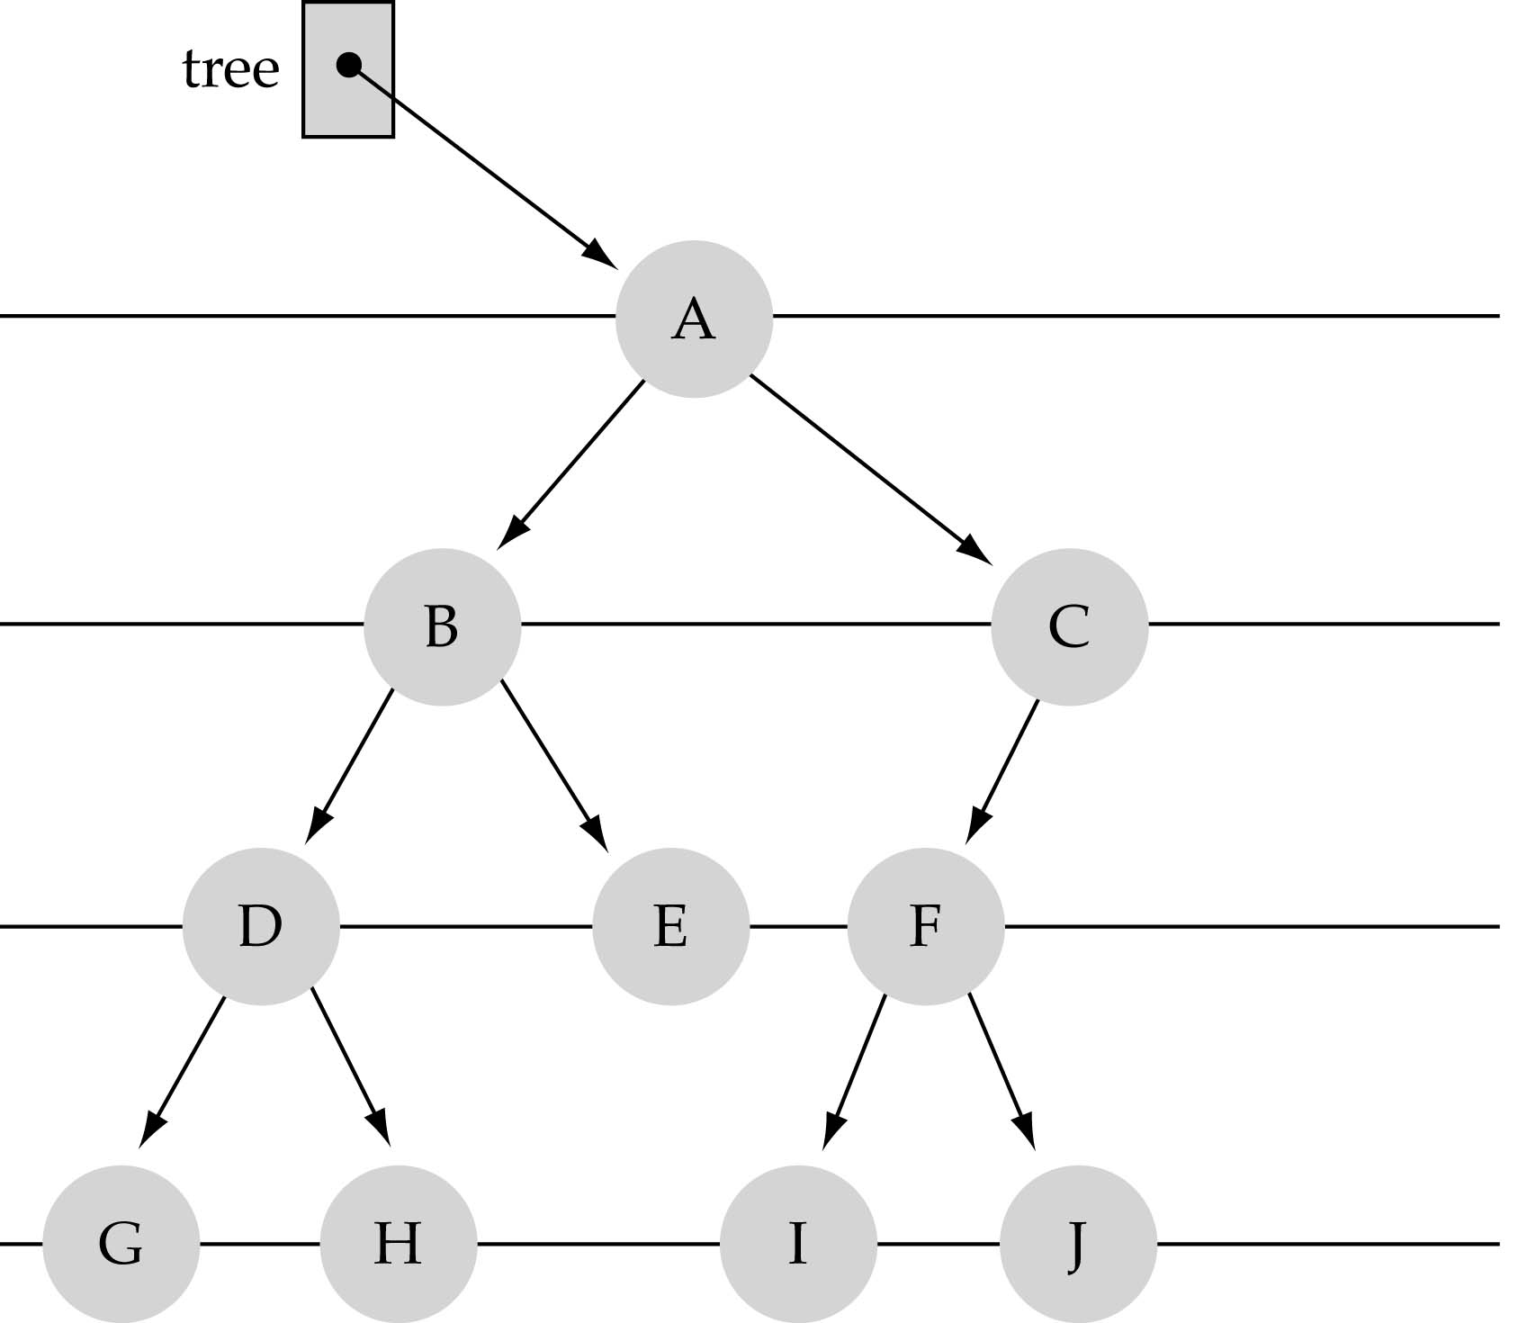
What is a binary tree?
Property 1: each node can have up to two successor nodes.

Slide 5
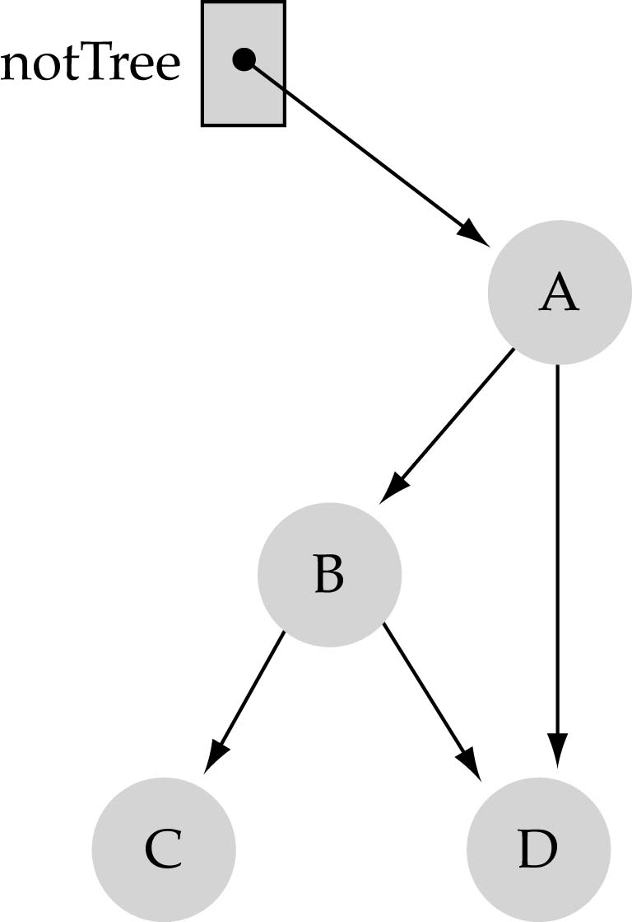
What is a binary tree? (cont.)
Property 2: a unique path exists from the root to every other node
Not a valid binary tree!

Slide 6
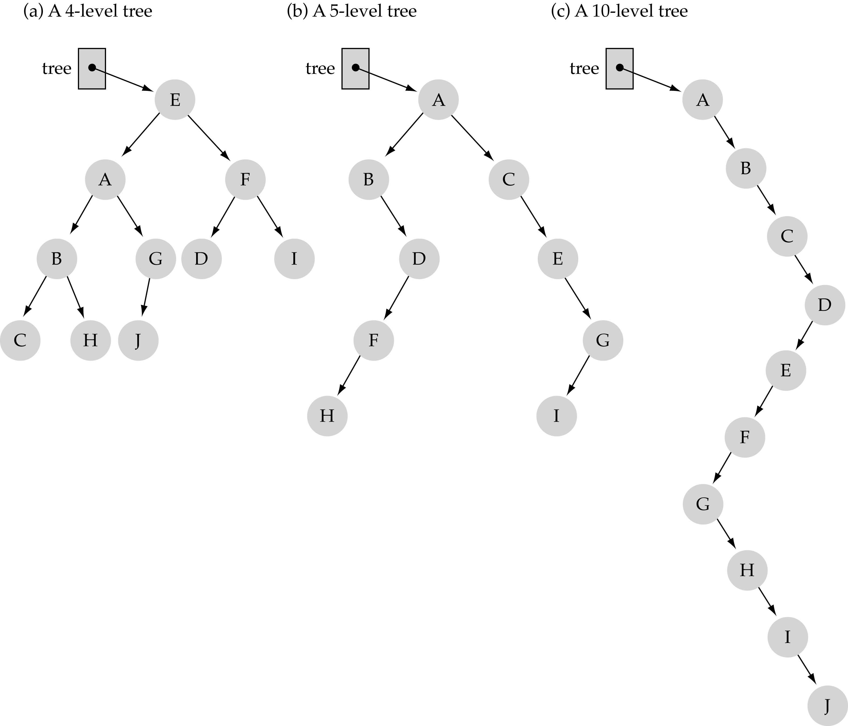
Some terminology
The successor nodes of a node are called its children
The predecessor node of a node is called its parent
The "beginning" node is called the root (has no parent)
A node without children is called a leaf

Slide 7
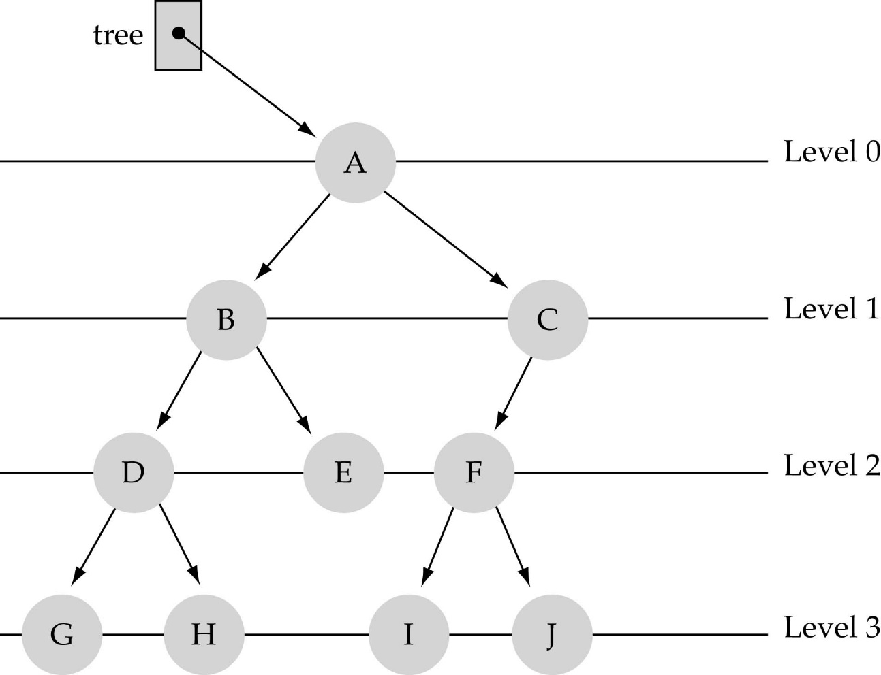
Some terminology (cont’d)
Nodes are organize in levels (indexed from 0).
Level (or depth) of a node: number of edges in the path from the root to that node.
Height of a tree h: #levels = L
Full tree: every node has exactly
two children and all the
leaves are on the same level.
not full!

Slide 8
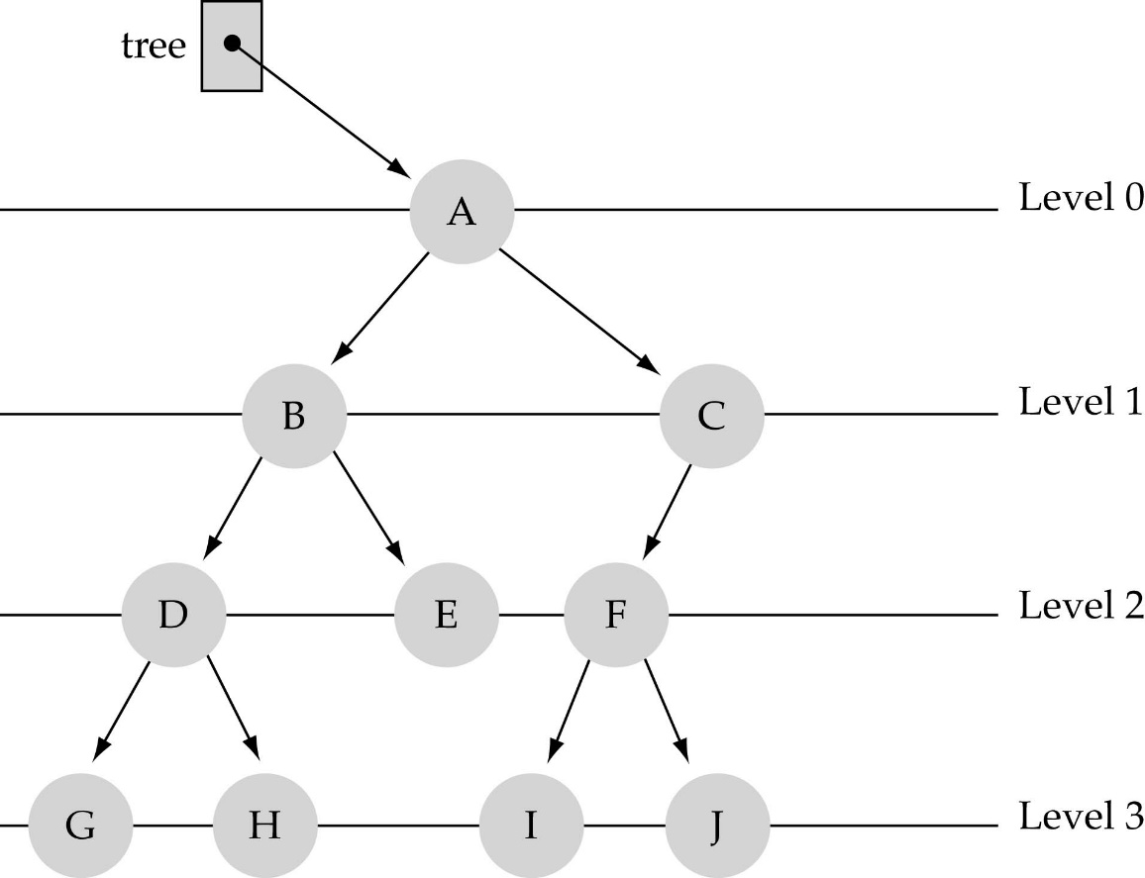
What is the max #nodes at some level l?
The max #nodes at level is
where l=0,1,2, ...,L-1

Slide 9

How to search a binary tree?
(1) Start at the root
(2) Search the tree level
by level, until you find
the element you are
searching for or you reach
a leaf.

Slide 10
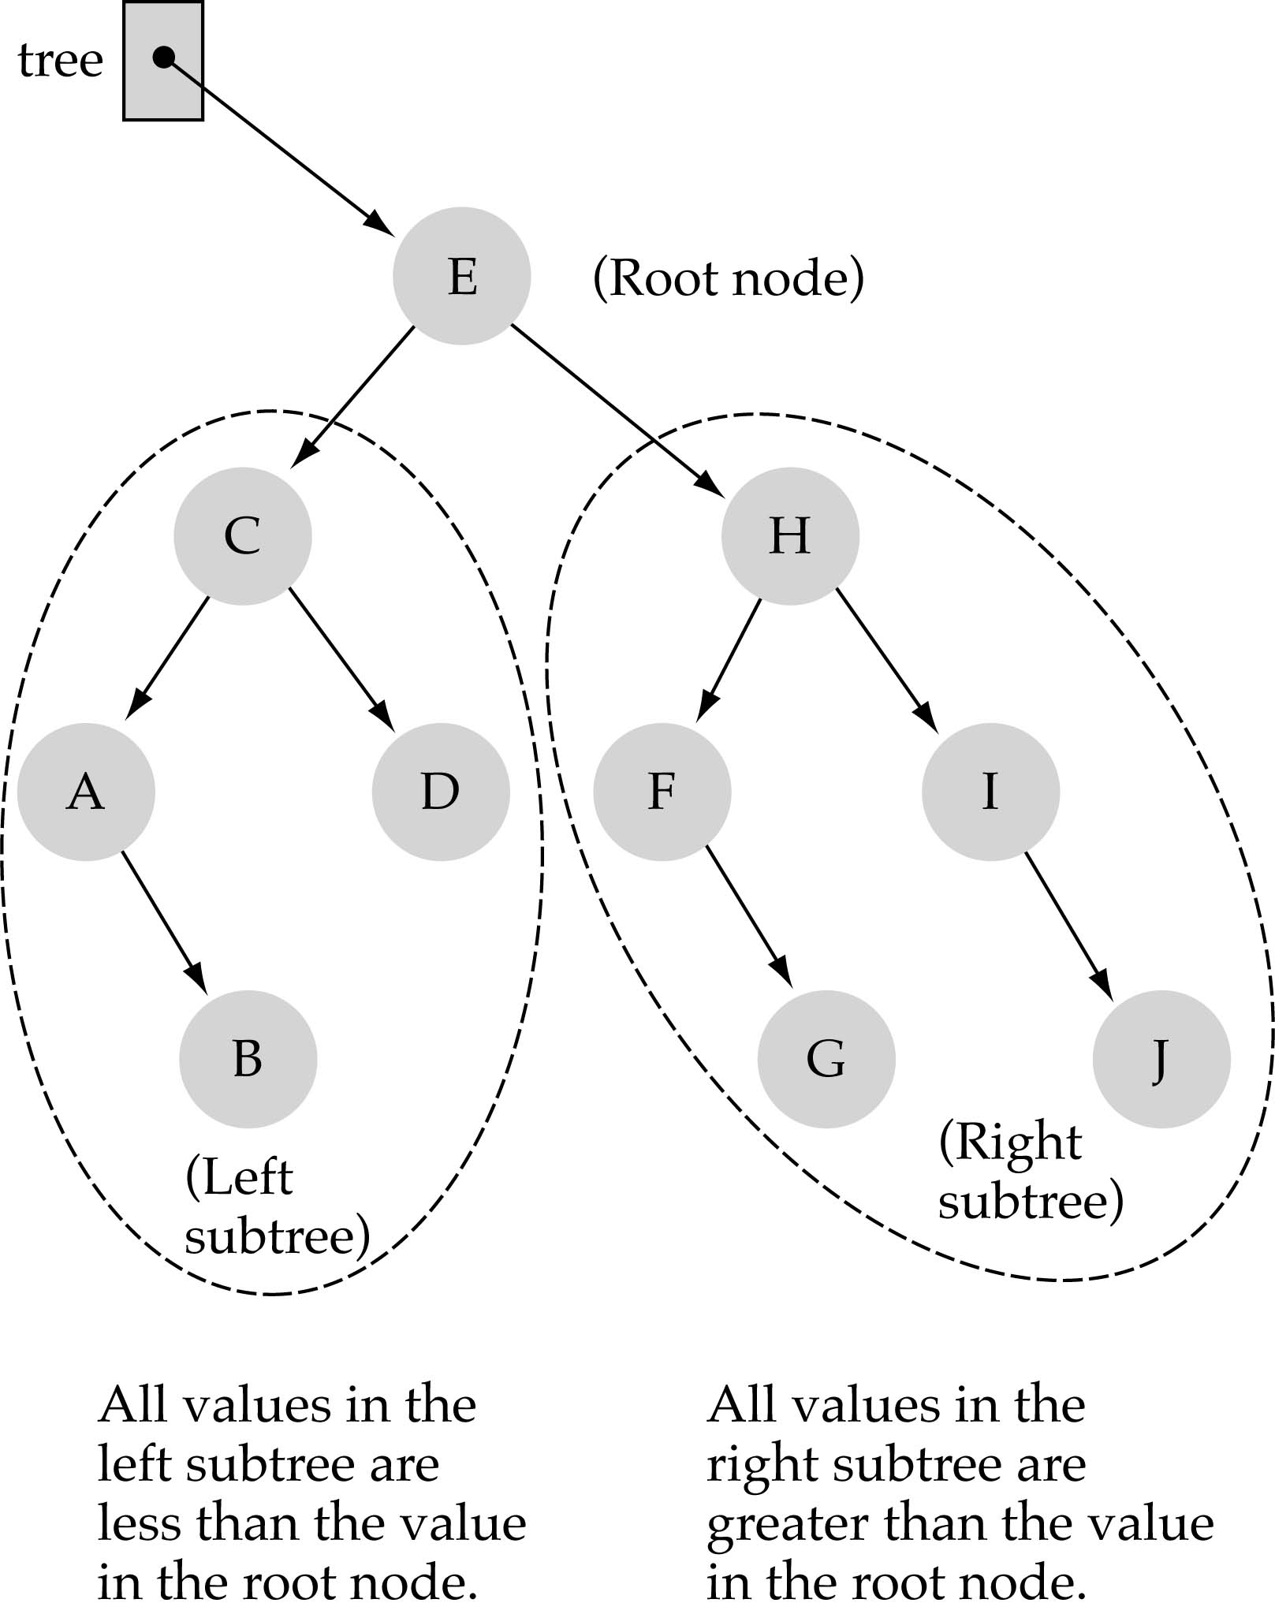
Binary Search Trees (BSTs)
Binary Search Tree Property:
The value stored at
a node is greater than
the value stored at its
left child and less than
the value stored at its
right child

Slide 11
Binary Search Trees (BSTs)
In a BST, the value stored at the root of a subtree is greater than any value in its left subtree and less than any value in its right subtree!

Slide 12
Binary Search Trees (BSTs)
Where is the smallest element?
Ans: leftmost element
Where is the largest element?
Ans: rightmost element

Slide 13
How to search a binary search tree?
(1) Start at the root
(2) Compare the value of the item you are searching for with the value stored at the root
(3) If the values are equal, then item found; otherwise, if it is a leaf node, then not found

Slide 14
How to search a binary search tree?
(4) If it is less than the value stored at the root, then search the left subtree
(5) If it is greater than the value stored at the root, then search the right subtree
(6) Repeat steps 2-6 for the root of the subtree chosen in the previous step 4 or 5

Slide 15
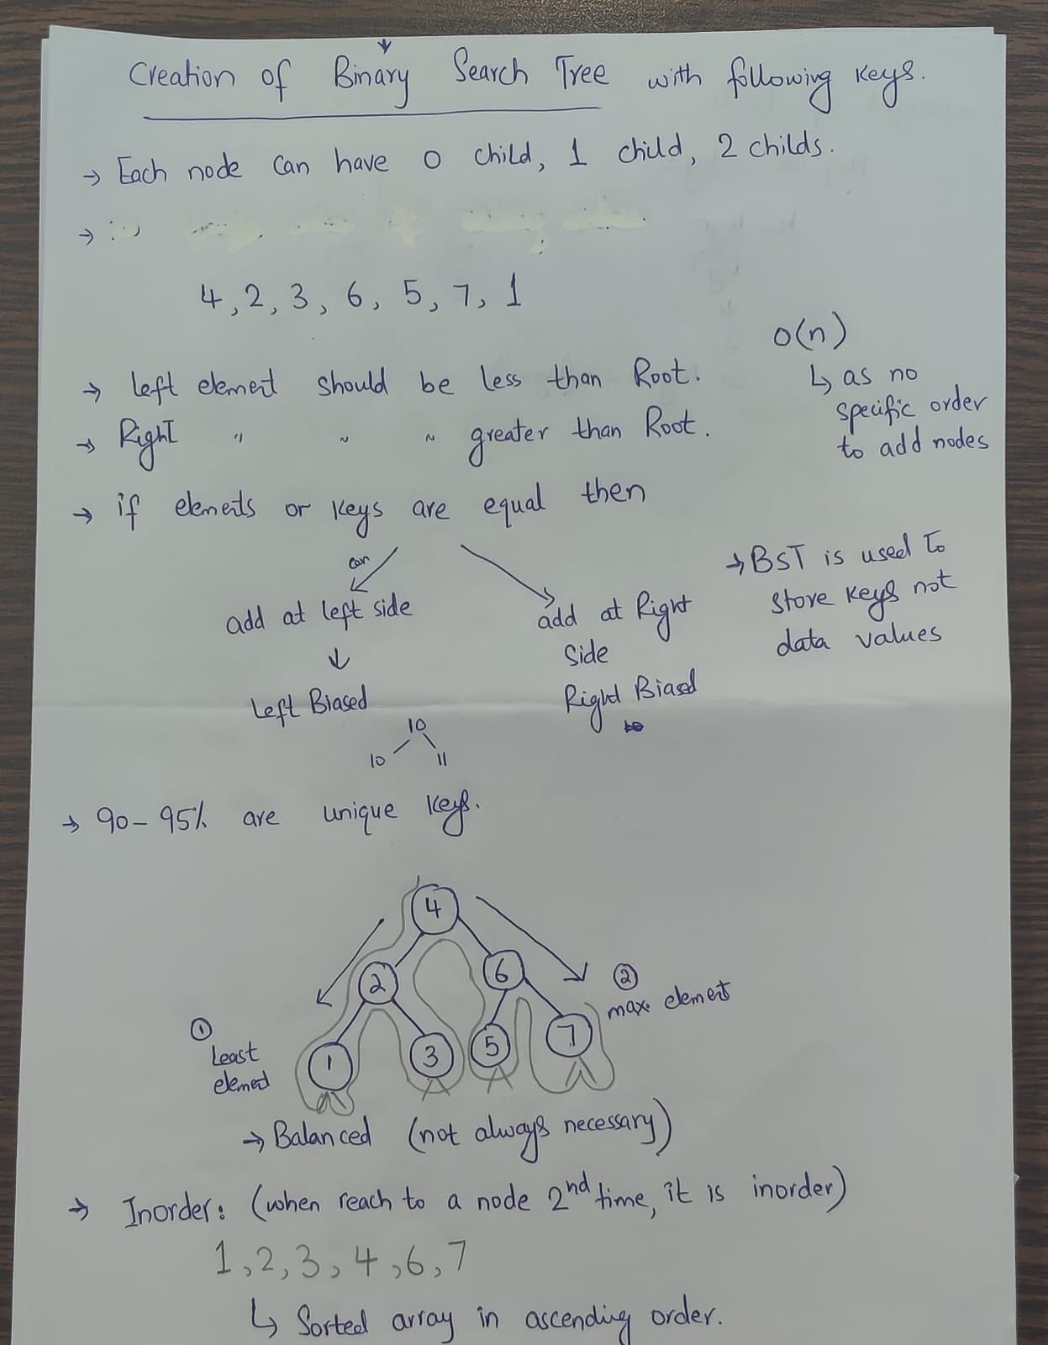

Slide 16
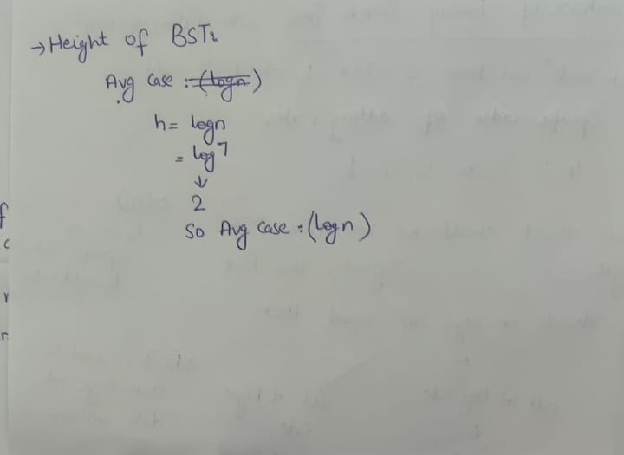

Slide 17
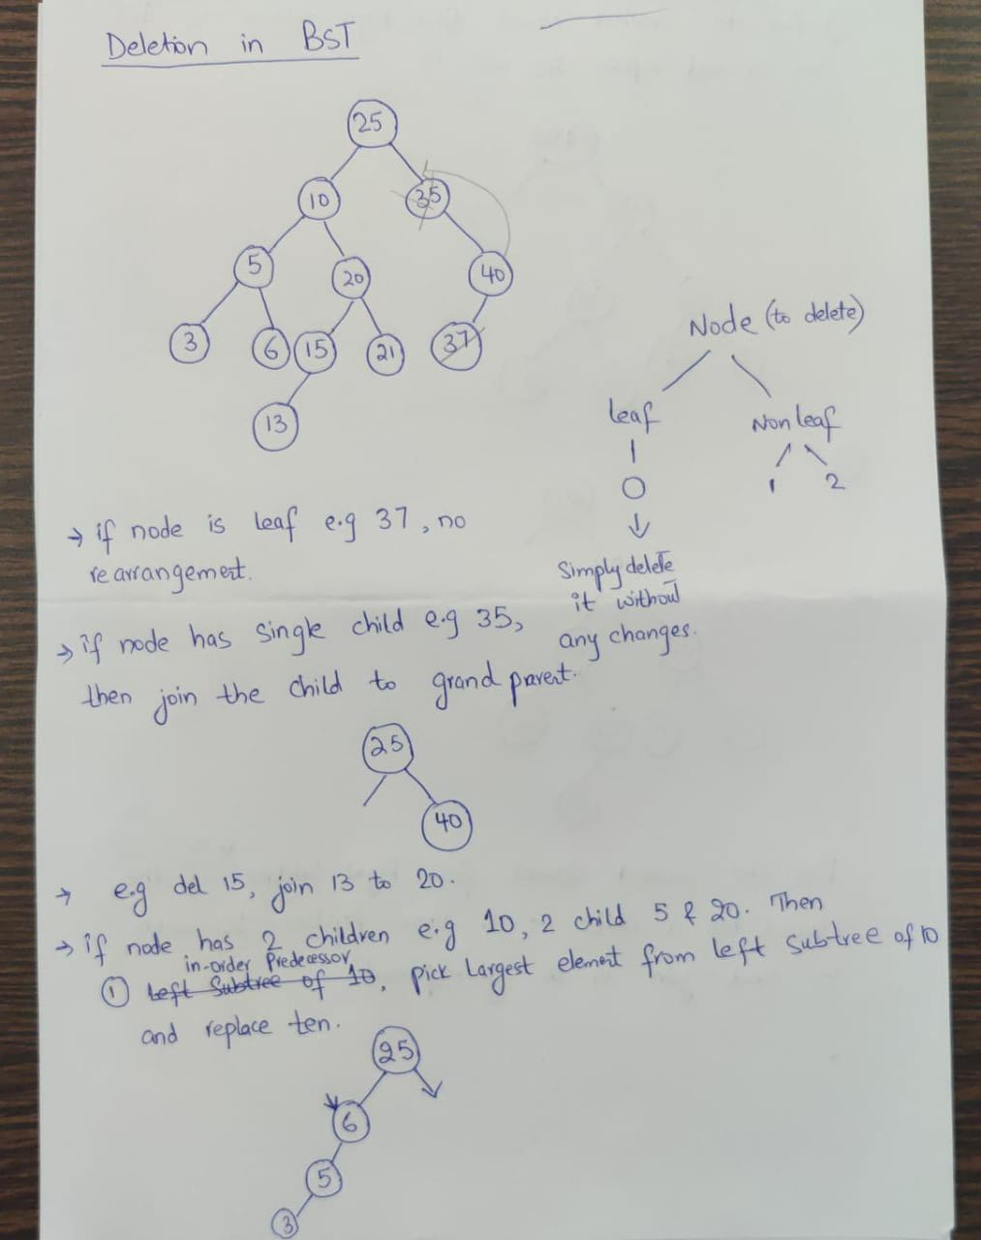

Slide 18
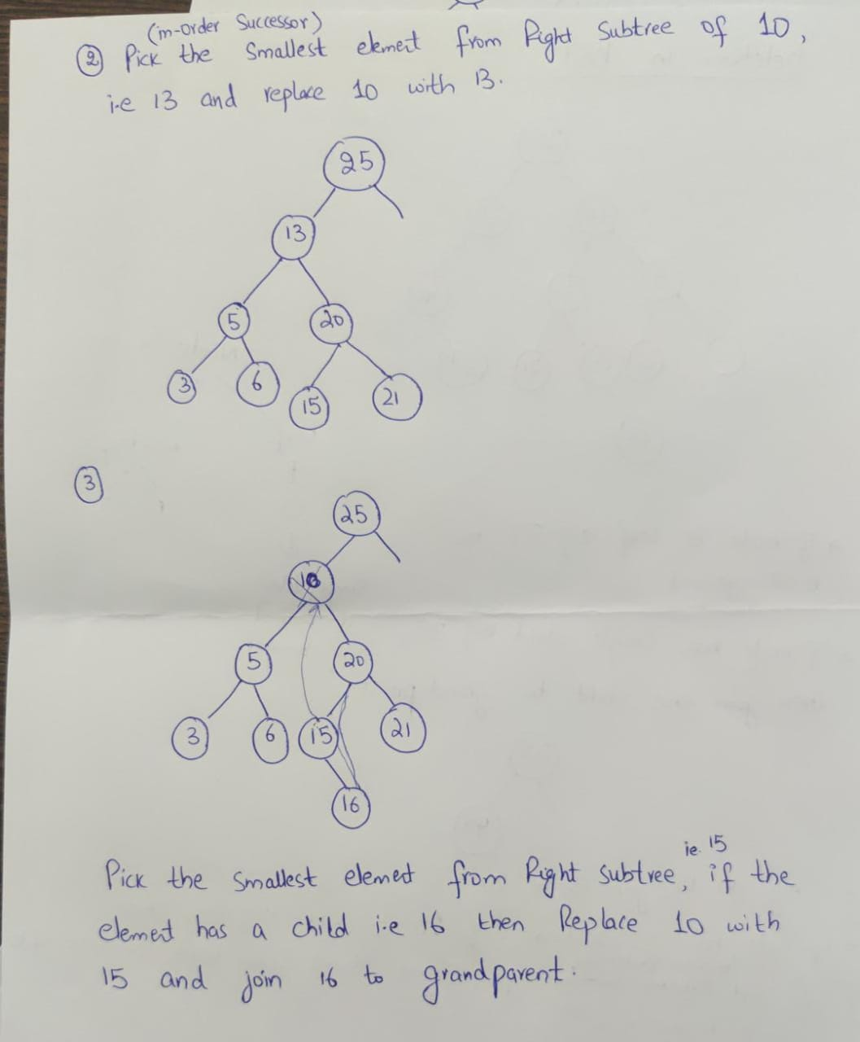

Slide 19
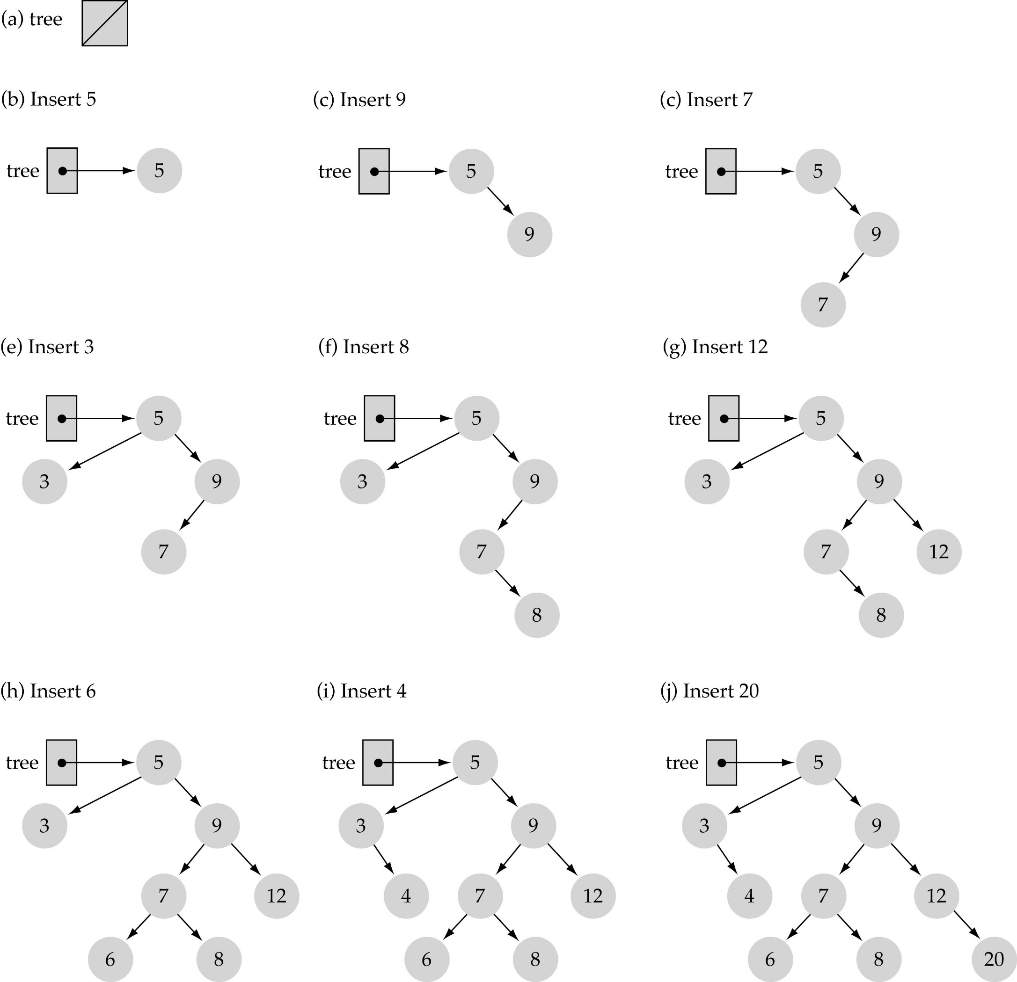
Insert node
Use the binary search tree property to insert the new item at the correct place

Slide 20
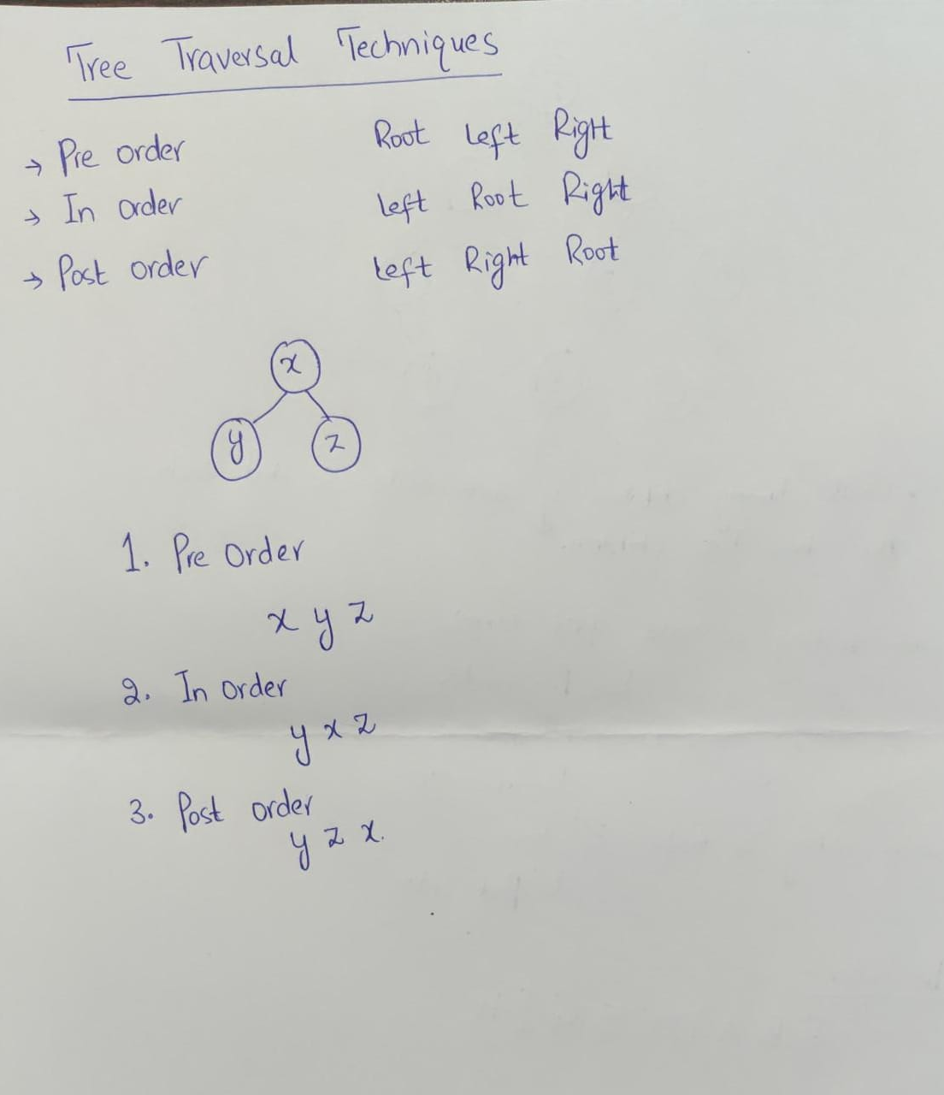

Slide 21
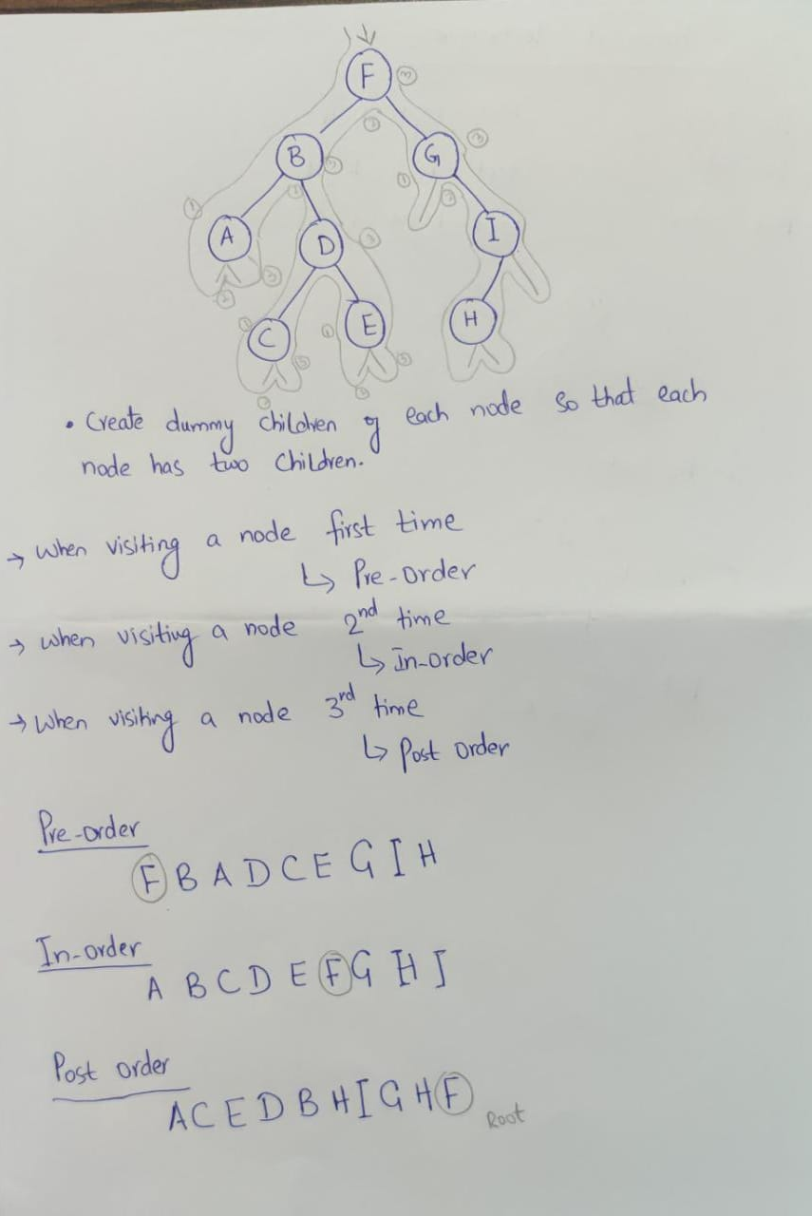

Slide 22
Construct a Binary search tree using the following keys.
6, 5, 9, 10, 11, 13, 4, 3, 7, 12
Traverse the tree using Pre-order, In-order, Post-order method

Slide 23
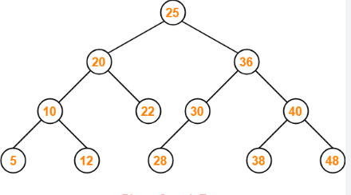
Delete node (40) Delete node (20) Delete node (30) Insert node (35)

